Slide 1
Guidelines and Priorities for safe Switching between plasma derived and recombinant Factor VIII
Alfonso Iorio
Parsian Azadi Hotel-Tehran-Iran , October 23th 2014

Slide 2
Alfonso Iorio
Associate Professor, Clinical Epidemiology & Biostatistics and Medicine, McMaster University
Director, Adult Hemophilia Centre, Hamilton
Chair, Health Information Research Unit, McMaster University
Co-founder Italian Registry for Congenital Coagulopathies;
Chair, Data and Demographics Committee, WFH
Chair Canadian Hemophilia Registry Program
Associate Editor: Blood Coagulation Disorders of the Cystic Fibrosis and Genetic Disorders Review Group of the Cochrane Collaboration
Notes:
Will introduce myself

Slide 3
References
Iorio, A. Blood, 2012: 120(4), 720–7.
Aznar, J. Haemophilia, 2014: 20(5), 624–9.
Matino D. Haemophilia, 2014: 20(5), 604–6.
Matino, D. Haemophilia, 2014: 20(2), 200-6.
Notes:
Will reassure I am basing the talk on literature I published, and very recently

Slide 4
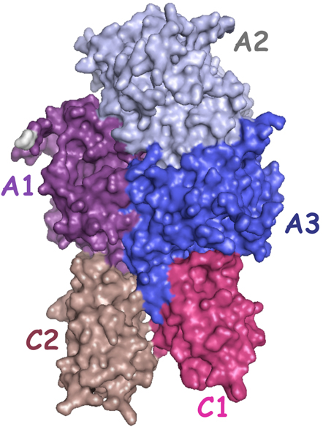
Why switching?
Evidence on switching
Recommendations
Priorities
Notes:
Will introduce to the topic

Slide 5
1 – why switching?
HG-US-0478e

Slide 6
Reasons for Switching factor concentrate
Improved Safety (real or perceived)
Less risk of infection
Less inhibitor risk
Fewer side-effects (e.g. allergic reactions)
Newer generation product
Price
National contracting
Volume of final product
Mixing and administration device
Storage advantage
Patient/family preference
Participation in clinical trial of new product/formulation
Research study participation that specifies product to be used
Iorio A et al. Blood 2012;120(4):720-727.
HG-US-0478e

Slide 7
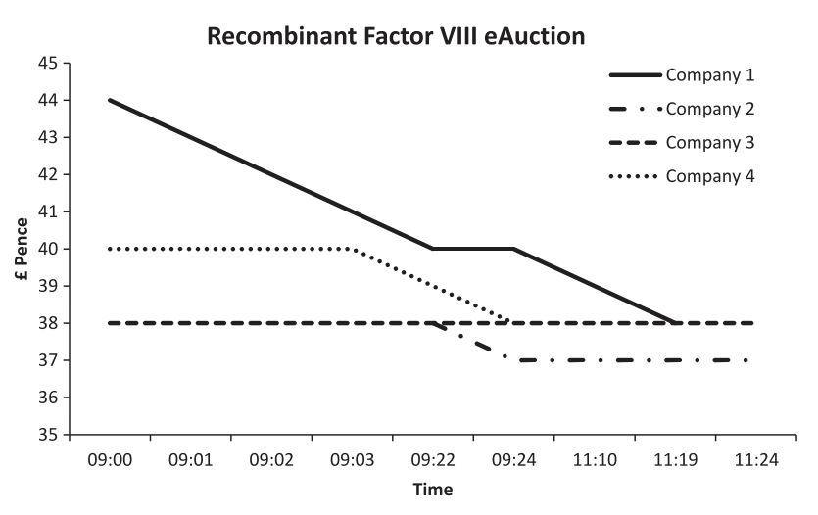
Hay, C. R. M. Hemophilia, 2013, 19(5), 660–7.

Slide 8
Barriers
Safety
Viral
Immunological
Efficacy
????

Slide 9
Guides for Assessing Causation
Plausibility | Is there a credible biological or physical mechanism that can explain the association?
Biological gradient | Are increasing exposures (ie dose duration) associated with increasing risks of the disease?
Experimental evidence | Is there any evidence from true experiments in humans?
Strength of association | How strongly associated is the putative risk with the outcome of interest?
Analogy | Is there a known relation between a similar putative cause and effect?
Consistency | Have the results been replicated by different studies, in different settings, by different investigators, and under different conditions?
Temporality | Did the exposure precede the disease?
Coherence | Is the association consistent with the natural history and epidemiology of the disease?
Specificity | Is the exposure associated with a very specific disease rather than a wide range of diseases?
Hill AB. Principles of Medical Statistics. New York: Oxford University Press, 1971.
HG-US-0478e
Notes:
(36) Common sense evidence but highly epidemiologically valid rules to assess causation

Slide 10
Multicausality principle¹
Previous F8 exposure
CTL-4 polymorphism
FVIII genotype
(missense/point)
IL10, TNF-a
polymorphism
FVIII genotype
(deletions/inversions)
F8
F8
Danger signal
F8
Danger signal
treatment
1. Rothman KJ, Greenland S. Am J Public Health. 2005;95:S144–50.
Modified from Gouw S. Semin Thromb Hemost 2007;35:723–34.
Notes:
(4) To comment about the interplay of several aspects

Slide 11
Iorio A et al. Blood 2012;120(4):720-727.
HG-US-0478e

Slide 12
The baseline risk
HG-US-0478e

Slide 13
2 – the evidence
HG-US-0478e

Slide 14
Published Risk of inhibitor development related to switching
Year | Lead Author | Design | Sample | Follow up months | Inhibitor | Rate X 1000 pts/yr | Notes
1988 | Giles et al. | Prospective | 478 | 12 | 18 | 0.019
 |  |  | 339 | 24 | 17 | 0.030
2007 | Singleton et al. | Retrospective | 94 | ≤20 | 4 | 0.042 | All patients
 |  |  | 77 | ≤20 | 1 | 0.013 | (-) history
2007 | Gouw et al. | Retrospective | 316 | (>50 ED) | NR
2008 | Rubinger | Prospective | 225 | 12 | 0 | 0
 |  |  | 189 | 24 | 0 | 0
2009 | Rea et al. | Retrospective | 33 | >3 | 1 | 0.033
2011 | Siegmund et al. | Retrospective # | 118 | N/A | 0
2011 | Bacon et al. | Retrospective | 113 | Up to > 100 ED | 1 | 0.009
N/A, not available; NR, not reported; ED, exposure day
Iorio A et al. Blood 2012;120(4):720-727.
HG-US-0478e
Notes:
BDD indicates B-domain deleted; ED, exposure day; NR, not reported; PTP, previously treated patients; and NA, not available.
*Rate of inhibitor positivity before switch was 0.079. When these patients were not excluded, rates were 0.038 at 12 months and 0.050 at 24 months.
†A total of 17 patients had history of previous inhibitors, of which 3 of developed a recurrence. All 4 inhibitors were transient, the only 1 de novo was secondary to surgery. At
study completion, 51 patients had 100 ED, and 24 had 20-100 ED.
‡The study enrolled PTPs and reported the RR for inhibitor development in 54 patients switching versus those not switching. The adjusted RR was 0.9 (95% confidence
interval 0.5-1.6).
§A total of 274 patients were tested at baseline, of which 4 were positive (0.014).
∏Cases observed over 8 years and switched from full-length to BDD factor VIII, the observed inhibitor was transient and secondary to surgery.
¶The cases were observed over 14 years, and switched from plasma-derived to recombinant factor VIII. A total of 101 patients had severe disease.
#The observed inhibitor was in a PTP. No recurrent inhibitors were observed after switching 16 patients with a positive inhibitor history.
Giles AR. Transfusion science. 1998;19:139-48.
Singleton E. Thromb Haemost. 2007;98:1188-92.
Gouw SC Blood. 2007;109:4693-7.
Rubinger M Haemophilia. 2008;14:281-6.
Rea C Haemophilia. 2009;15:1237-42.
Siegmund B. Hämostaseologie. 2010;30 S1:S37-9.
Bacon CL Haemophilia. 2011;17:407-11.

Slide 15
Secular trend in the estimated risk of inhibitor development in PTPs
Cumulative rates observed progressively increased over time from 0.0015 to 0.0053
What might the effects be due to?:
Increased awareness
More accurate and frequent inhibitor testing;
May reflect more the widespread use of:
Prophylaxis
Greater factor consumption
More frequent switching
May parallel temporal trends toward more frequent allergic and autoimmune disorders
HG-US-0478e

Slide 16
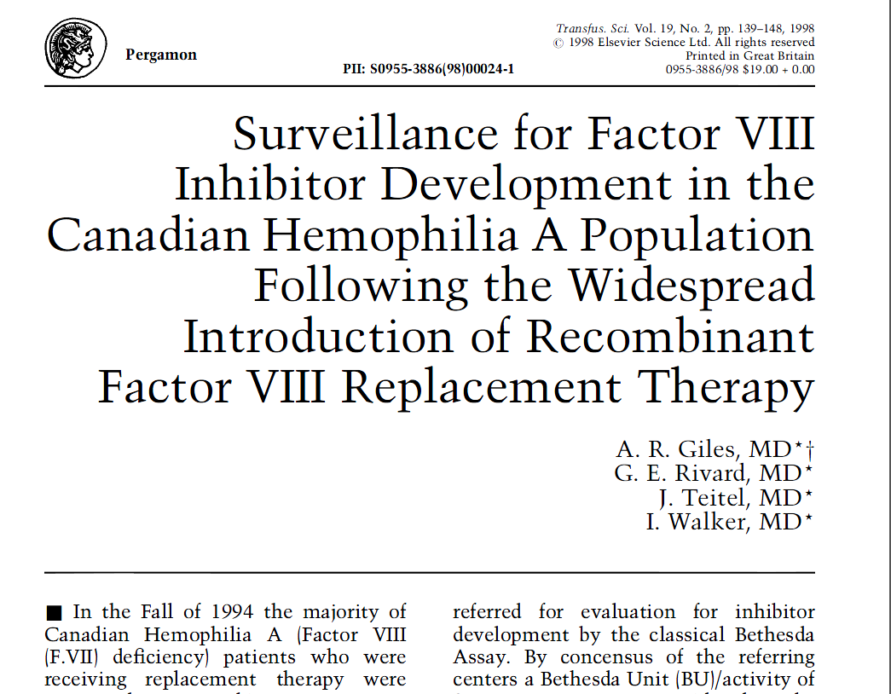
Giles, et al. Tranfus. Sci. 1998;19(2): 9-48. .
HG-US-0478e

Slide 17
Conversion of Canada Hemophilia A Population to High-Purity Products
 | Inhibitors/at risk (%)
 | Recombinant FVIII |  | Affinity purified pdFVIII
Post | 18/478 | 3.8% | 4/57 | 7%
Missing at baseline | 0/55 |  | 0/4
Positive at Baseline | 9/423 | 1.9% | 4/53 | 7.5%
Negative at baseline | 9/423 | 1.9% | 0/53 | 0%
Giles, et al. Tranfus. Sci. 1998;19(2): 9-48
HG-US-0478e
Notes:
Rubinger M et al. Haemophilia 2007; 14:281–6.
UKHCDO switch study. Hay C, personal communication

Slide 18
97/167 with > 150 ED
9 inhibitors, all transient

Slide 19
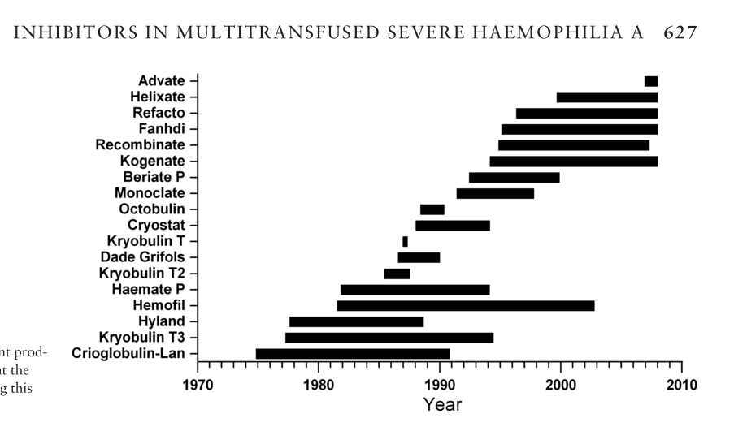
Aznar, J. Haemophilia, 2014: 20(5), 624–9.

Slide 20
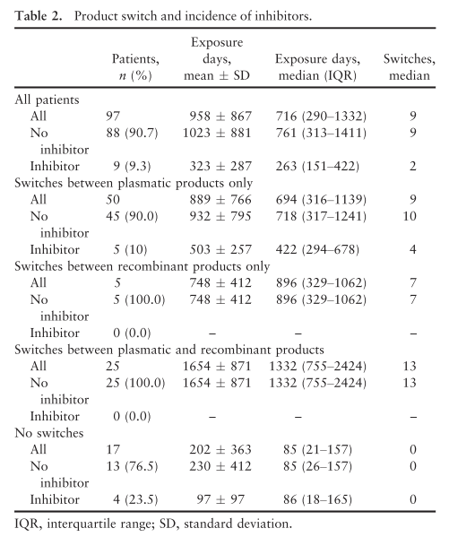

Slide 21
Product switch and incidence of inhibitors
Patients | All | PD-only | Rec-only | PD-Rec | No switch
All | 97 | 50 | 5 | 25 | 17
Inhib (-) | 88 (91) | 45 (90) | 5 | 25 | 13 (76)
Inhib (+) | 9 (9) | 5 (10) | 0 | 0 | 4 (23)
Aznar, J. Haemophilia, 2014: 20(5), 624–9.

Slide 22
3 - Recommendations
HG-US-0478e

Slide 23
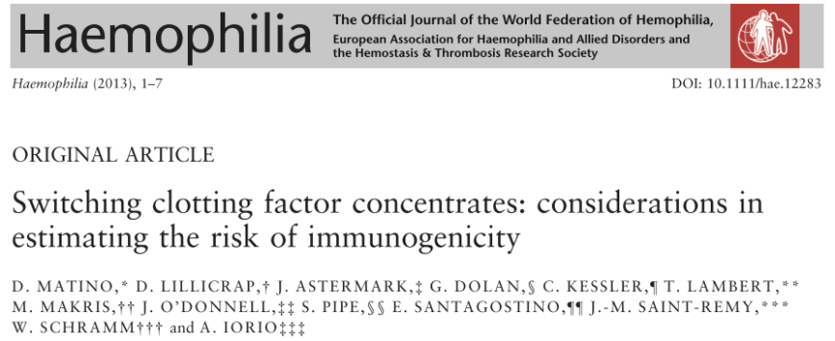
A Modified Delphi Technique was used to add to the considerations of the risk of FVIII immunogenicity associated with product switching
Structured group communication involving 12 expert panelists
14 items were identified and ranked, followed by preparation of statements
Matino D, et al. Haemophilia 2013; 1-7. DOI:10.1111/hae.12283.
HG-US-0478e

Slide 24
Outcome of Delphi Consensus Process: Items and Statements
Item 1. Evidence documenting an increased risk of FVIII inhibitor development with product switching is weak
Item 2. The risk of inhibitor development is likely to be less with FIX product switches compared to FVIII switches
Item 3. FVIII inhibitor development is more likely when product switches occur during the first 50 exposure days
Item 4. The risk of FVIII inhibitor development may be increased with the new FVIII conjugates and fusion proteins
Item 5. The risk of an inhibitor after switching may be different for severe vs. moderate or mild haemophilia
Matino D, et al. Haemophilia 2013; 1-7. DOI:10.1111/hae.12283.
HG-US-0478e

Slide 25
Outcome of Delphi Consensus Process: Items and Statements (cont’d)
Item 6. The risk of FVIII inhibitor development with product switching is increased in patients with a past history of an inhibitor
Item 7. There may be an increased risk of inhibitor development when switching product just prior to surgery or intensive treatment
Item 8. The risk of a FVIII inhibitor development increases with the frequency of product switching
Item 9. There is an increased risk of FVIII inhibitor development when switching concentrates in patients being treated on demand as opposed to prophylactically
Matino D, et al. Haemophilia 2013; 1-7. DOI:10.1111/hae.12283.
HG-US-0478e

Slide 26
Outcome of Delphi Consensus Process: Items and Statements (cont’d)
Item 10. There is an increased risk of FVIII inhibitor development when switching between plasma-derived and recombinant FVIII concentrates
Item 11. There is an increased risk of FVIII inhibitor development when switching between B-domain deleted and full-length FVIII concentrate
Item 12. FVIII inhibitor risk associated with recombinant FVIII use could be influenced by the type of cell employed for FVIII production
Item 13. All recombinant FVIII products have the same risk of inhibitor development
Item 14. The risk of FVIII inhibitor development with product switches can be predicted by genetic analysis
Matino D, et al. Haemophilia 2013; 1-7. DOI:10.1111/hae.12283.
HG-US-0478e

Slide 27
Item 10. There is an increased risk of FVIII inhibitor development when switching between PD and rec FVIII concentrates
A. There is no evidence to support this statement. The Canadian sur- veillance of product switching for the entire population to recombinant FVIII in 1988 did not show any increase in the baseline risk for inhibitor development (92%).
B. There is no evidence that the risk of inhibitor development associated with switching from any plasma-derived concentrate to any recombinant prod- uct is different from that associated with switching between two different plasma-derived or two recombi- nant factor concentrates (77%).
Matino D, et al. Haemophilia 2013; 1-7. DOI:10.1111/hae.12283.
HG-US-0478e

Slide 28
4 – Priorities and directions
HG-US-0478e

Slide 29
Key messages
No signal of increased immunogenecity for recombinants
No signal of risk around switching
“Natural experiments” of switching should be optimized to gain further knowledge

Slide 30
Key Messages
The process
The evidence
The future
Studies around switching are complex
Imperfect but overall reassuring
“Natural experiments” should be optimized
No signal of increased immunogenicity when switching from PD to recombinant FVIII
HG-US-0478e

Slide 31
Thank You iorioa@mcmaster.ca hemophilia.mcmaster.ca
HG-US-0478e

